Slide 1
Please Put phones and devices in a pocket in your backpack. Thank you
Essential Question: What properties of inverse functions for linear and quadratic functions are the same for exponential functions? Can these properties be generalized.

Slide 2
Warm Up
There are 3 ways to describe how we know if 2 functions are inverses. Name 2 of them.
2. Make up a table for f(x) and then using the f(x) table make a table for f⁻¹(x)
3. Write an equation for f(x) and then the equation for f⁻¹(x)

Slide 3
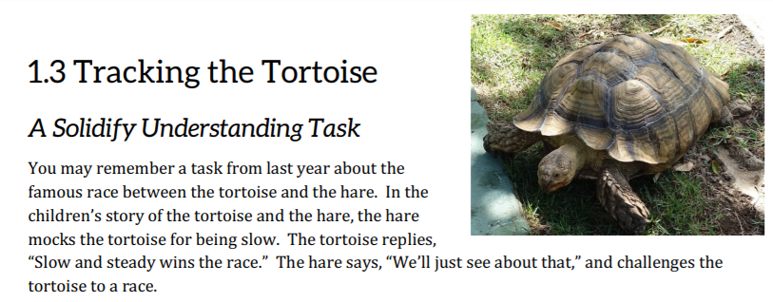

Slide 7
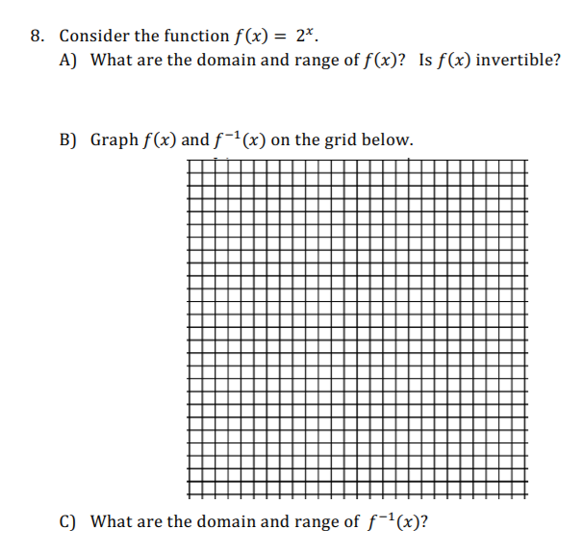

Slide 9
Notes:
Exponential: $y=2^{x}$ Dom: ($−∞,∞)$ Range $(0,∞)$
Inverse of Exponential: $x=2^{y}$ Dom: $\left(0,∞\right)$ Range: $(−∞,∞)$
We need to solve for y. How do you do that? The inverse of exponential functions is called logarithmic functions.
$$x=2^{y} becomes y=\log_{2}{x}$$
Definition of Log
$$if {base}^{exp}=ans, then \log_{base}ans=exp$$

Slide 12
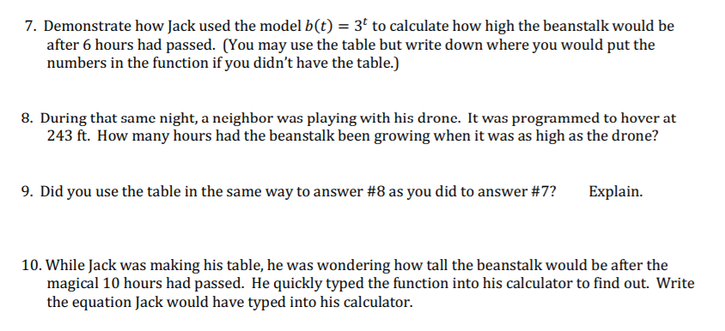

Slide 13
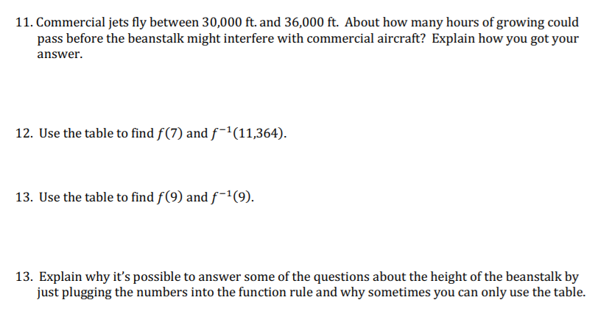

Slide 14
