Slide 1
Please Put phones and devices in a pocket in your backpack. Thank you
Essential Question: How can we be sure that two functions are inverses? How can we find inverse functions?

Slide 2
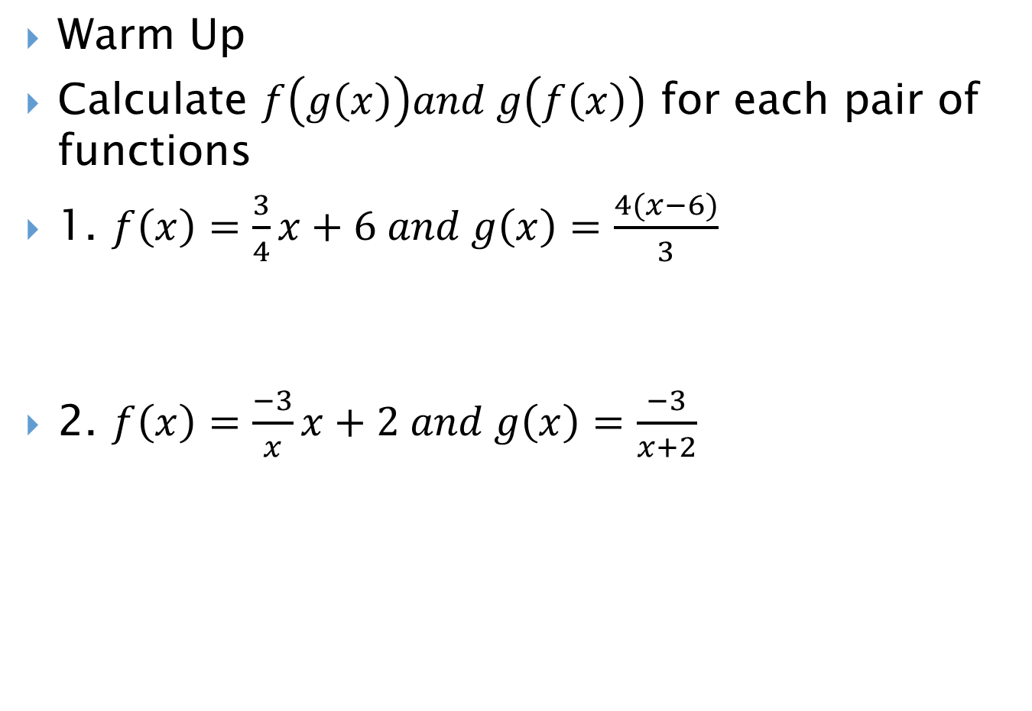
Warm Up
Calculate $f\left(g\left(x\right)\right)and g\left(f\left(x\right)\right)$ for each pair of functions
1. $f\left(x\right)=\frac{3}{4}x+6 and g\left(x\right)=\frac{4(x−6)}{3}$
2. $f\left(x\right)=\frac{−3}{x}x+2 and g\left(x\right)=\frac{−3}{x+2}$

Slide 5
