Slide 1
Please Put phones and devices in a pocket in your backpack. Thank you
Essential Question: Can the graphs of logarithmic functions give us insight into some of the algebraic properties of logarithms?

Slide 2
Warm Up
1. Write as a logarithm $5^{3}=125$
2. Write as an exponent $\log_{3}81=4$
Simplify the logarithm
3. $\log_{3}243=$
Write each answer as an exponent. Simplify each expression. Answers should only have positive exponents.
4. (${{(x)}^{−4})}^{2}$
5. $({{5x}^{3})}^{2}$
Use the properties of logarithms to expand:
$$\log_{3}\frac{x^{2}}{yz^{4}}$$

Slide 4
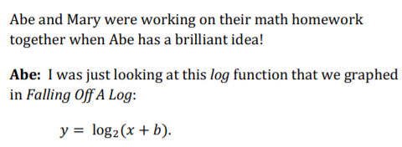
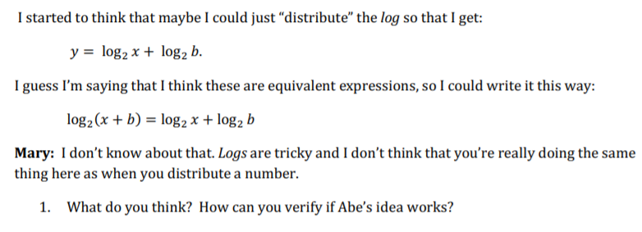

Slide 7
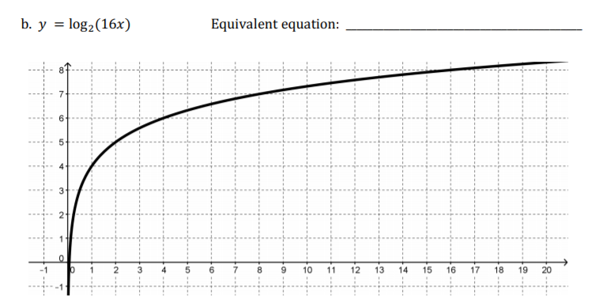

Slide 8
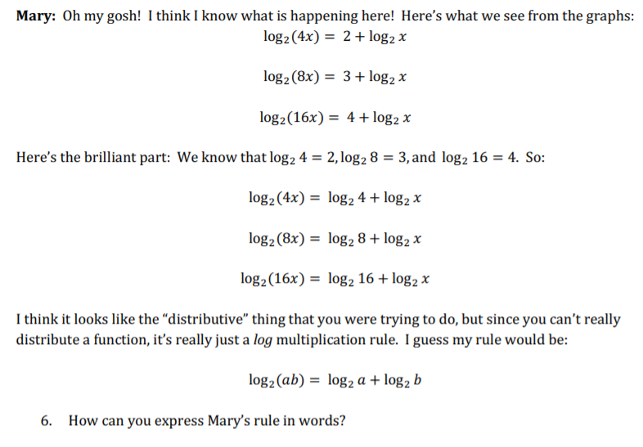

Slide 9
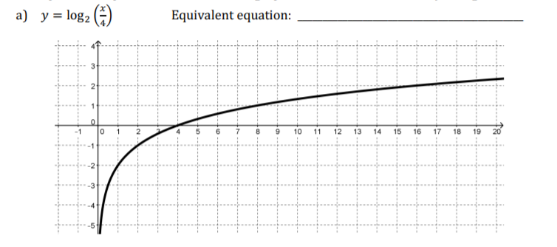

Slide 10
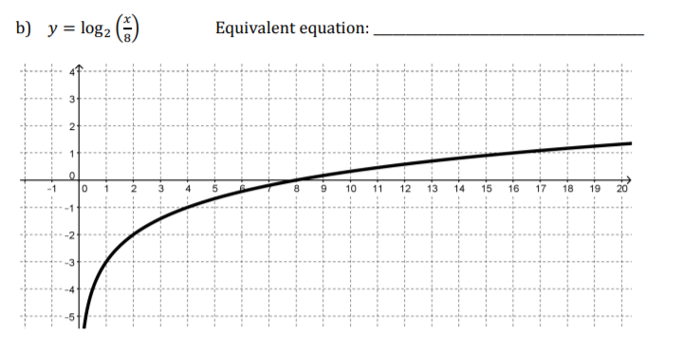

Slide 12
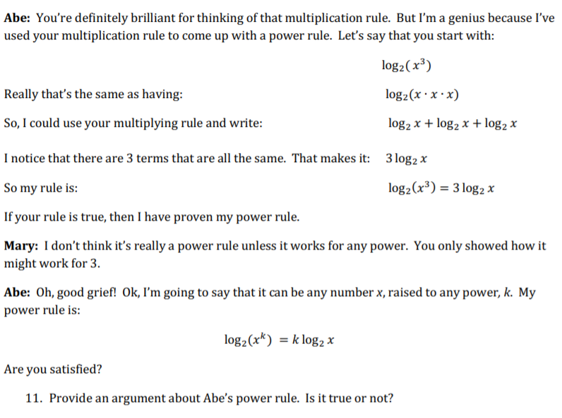

Slide 14
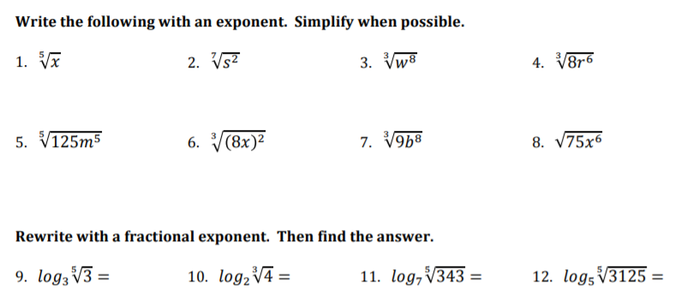

Slide 15
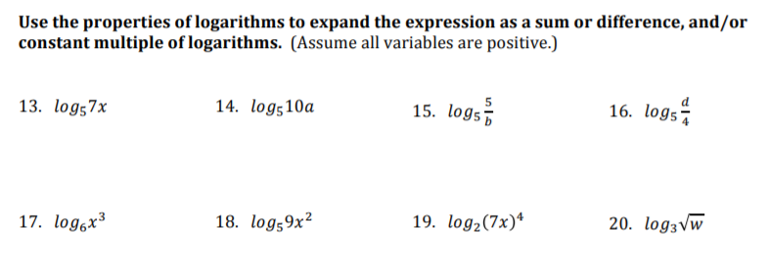

Slide 16
Please Put phones and devices in a pocket in your backpack. Thank you

Slide 17
