Slide 1
Wednesday Warm Up
Find the zeros
1. $f\left(x\right)=\frac{2}{3}x+4$
2. $f\left(x\right)=5x^{2}−10x−15$
Distribute
3. $\left(x+\sqrt{2}\right)\left(x−\sqrt{2}\right)$
4. $(2+5i)(2−5i)$
5. Write the quadratic formula

Slide 2
Please Put phones and devices in a pocket in your backpack. Thank you
Essential Question: How do polynomials compare to other functions? How are polynomials like integers?

Slide 3
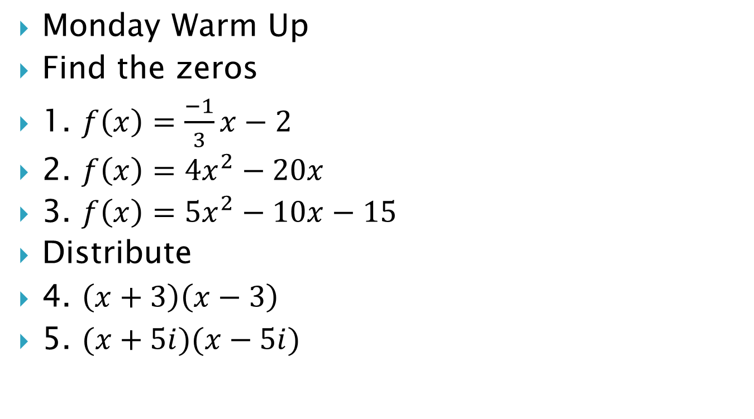
Monday Warm Up
Find the zeros
1. $f\left(x\right)=\frac{−1}{3}x−2$
2. $f\left(x\right)=4x^{2}−20x$
3. $f\left(x\right)=5x^{2}−10x−15$
Distribute
4. $\left(x+3\right)\left(x−3\right)$
5. $(x+5i)(x−5i)$

Slide 4
EQ: How do polynomials compare to other functions? How are polynomials like integers?

Slide 22
Name the conjugate
$x+3$
$5i$
$−2−i$
$−4+\sqrt{2}$
$−3\sqrt{7}$

