Slide 1
Please Put phones and devices in a pocket in your backpack. Thank you
EQ: What other functions can be made from $f\left(x\right)=\frac{1}{x}$?
What will their graphs look like?

Slide 2
Warm Up
Find the zeroes
1. $(9x+3)(x^{2}−9)$
2. $(x^{2}+25)$
Use the given root to find the remaining roots. Then write the function in factored form.
3. $f\left(x\right)=x^{3}−x^{2}−17x−15 x=−1$
4. $f\left(x\right)=6x^{3}−18x^{2}−60x x=0$

Slide 3
EQ: What other functions can be made from $f\left(x\right)=\frac{1}{x}$? What will their graphs look like?

Slide 12
Transformations of rational functions
$f\left(x\right)=\frac{1}{x}+c up c$
$f\left(x\right)=\frac{1}{x}−c down c$
$f\left(x\right)=\frac{1}{x+c} left c$
$f\left(x\right)=\frac{1}{x−c} right c$
$f\left(x\right)=−\frac{1}{x} reflection about x−axis$

Slide 13
A point of discontinuity is either a hole or a vertical asymptote.
If it makes the denominator equal zero
but does not make the numerator equal zero it is an asymptote.
If it makes both the denominator and
the numerator equal zero it is a hole.

Slide 14
Horizontal Asymptotes
Look at the degree on the numerator (N) and the denominator (D)
If $N>D$ None $\frac{x^{2}+1}{x}$
If $N<D$ $y=0$ $\frac{x+1}{x^{2}}$
If $N=D$ $y=\frac{lead coef of N}{lead coef ofD}$ $\frac{2x^{2}+3}{{5x}^{2}−1}$ $y=\frac{2}{5}$

Slide 15
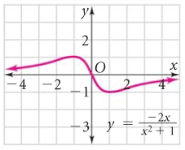

Slide 16
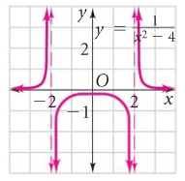

Slide 17
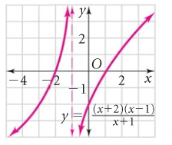

Slide 18
a. y =
3
x² – x –12

