Slide 1
Please Put phones and devices in a pocket in your backpack. Thank you
EQ: How do I find the volume of a solid of revolution that isn’t a cylinder or part of a cone?

Slide 2
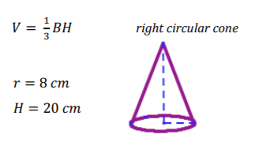
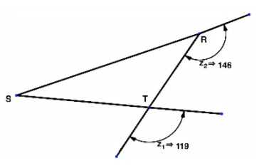
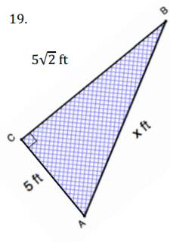
Warm Up
1. Find the surface area of a rectangular prism with $l=3 in, w=4 in, and h=5 in$
2. Find the volume:
3. Calculate the missing
side of the right triangle
Leave your answer in 4.
simplified radical form:

Slide 3
EQ: How do I find the volume of a solid of revolution that isn’t a cylinder or part of a cone?

Slide 4
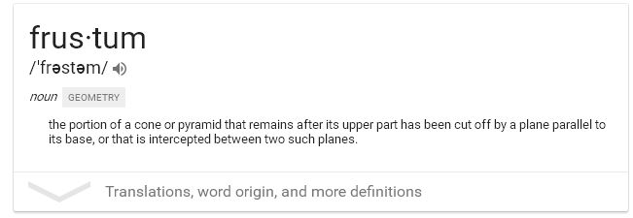
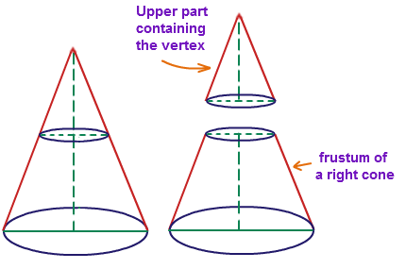

Slide 5
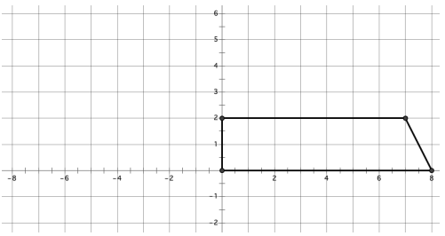

Slide 6
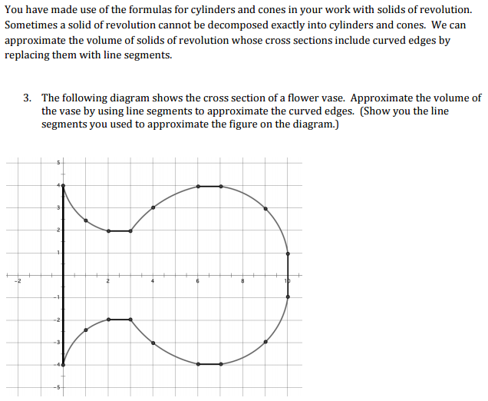

Slide 7
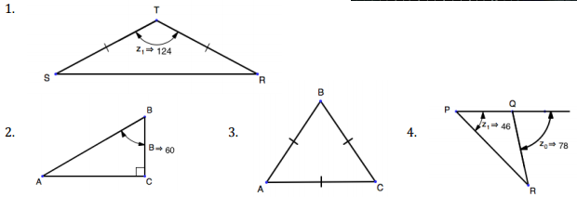

Slide 8
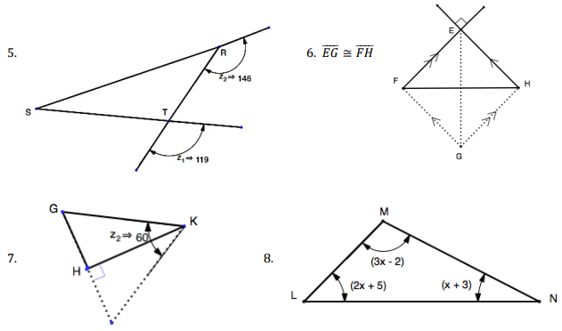

Slide 10
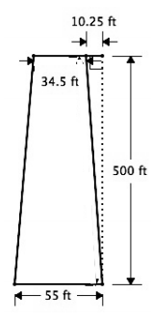

Slide 11
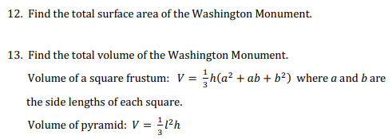

Slide 13
