Slide 1
Please Put phones and devices in a pocket in your backpack. Thank you
EQ: How can I use quantities and units to guide my computational thinking in a modeling context?

Slide 2
Warm Up
Fill in all the missing measures in the triangles
1. 2.
$$f\left(x\right)=x+1 g\left(x\right)=−2x+3$$
$f\left(x\right)+g\left(x\right)$
$f\left(x\right)−g\left(x\right)$
$f\left(x\right)g\left(x\right)$
$\frac{f(x)}{g(x)}$

Slide 3
EQ: Why are 30-60-90 and 45-45-90 triangles considered to be “special?”

Slide 5
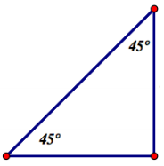

Slide 6
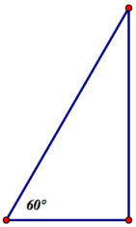

Slide 8
Special Triangle Notes
A 30-60-90 triangle has A 45-45-90 triangle has
a short leg $(sl)$, two legs the same length
a long leg $(ll)$ and and hypotenuse
hypotenuse
$x\sqrt{3}$ x
2x
$$x\sqrt{2}$$
x
x

