Slide 1
Please Put phones and devices in a pocket in your backpack. Thank you
EQ: How can I use the Pythagorean theorem to find the lengths of sides of non-right triangles?

Slide 2
Warm Up
Draw a right triangle, One leg is length 5 and the other leg is length 12
Find the third side of the triangle
Find the perimeter of the triangle
Find the area of the triangle
Select an angle that is not the right angle and identify:
A. Sin=
B. Cos=
C. Tan=
5. Change 60 miles per hour into feet per second.
The cherry soda can has a height of 4 inches
And a diameter of 2 inches.
6. Find the radius of the can
7. Find the surface area of the can
8. Find the volume of the can

Slide 3
EQ: How can I use the Pythagorean theorem to find the lengths of sides of non-right triangles?

Slide 4
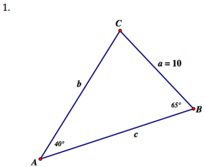
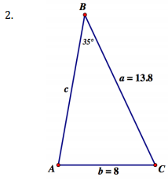

Slide 5
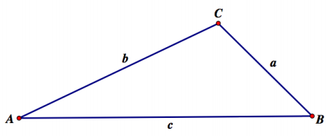

Slide 6
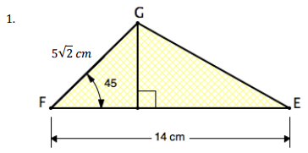
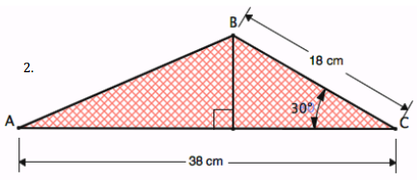

Slide 7
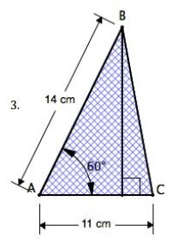
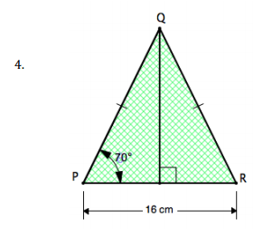
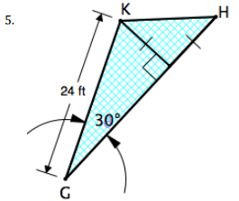

Slide 8
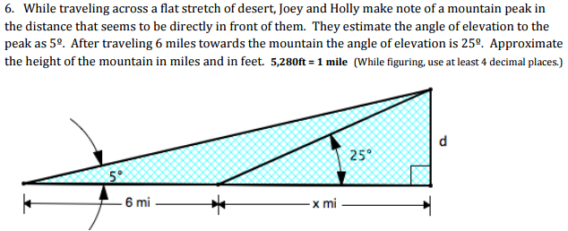

Slide 9
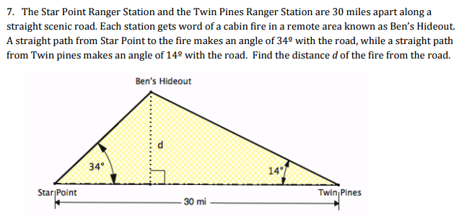

Slide 10
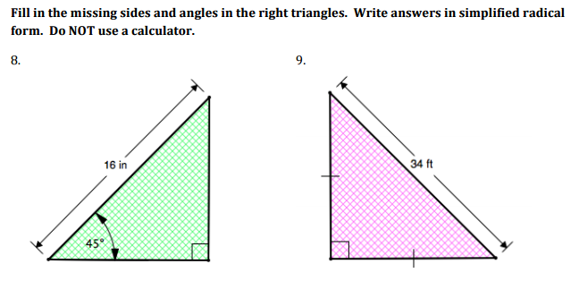

Slide 11
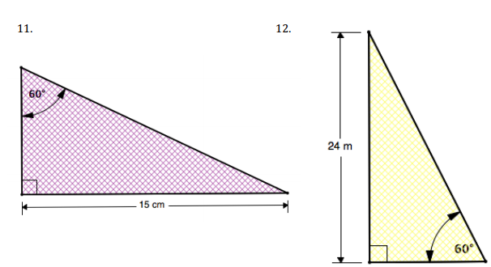

Slide 12
