Slide 1
Please Put phones and devices in a pocket in your backpack.
Thank you
EQ: What happens to the relationship between the areas of the square on the three sides of a triangle when the triangle is not a right triangle?

Slide 2
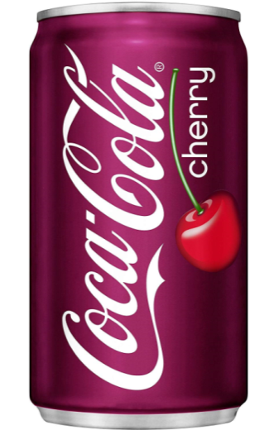
Warm Up
The cherry soda can has a height of 4 inches
And a diameter of 2 inches.
Draw a two-dimensional shape that would need
to be revolved around the x-axis to create the can
of soda you see on the right.
2. Find the lengths of all the dotted lines
in the picture below the can.
3. Find the surface area of the can.
4. Find the volume of the can.
They don’t fill the can to the
exact top or the liquid would
spill when opened.
5. What is the volume of the
liquid if there is ¼ inch of air
at the top?
This is a picture of the can

Slide 3
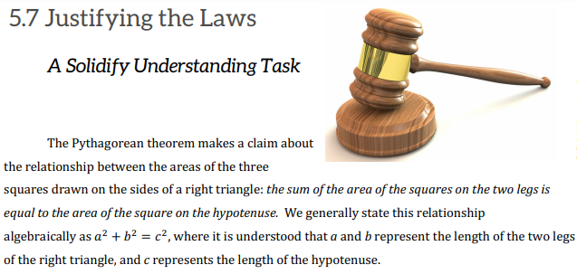

EQ: What happens to the relationship between the areas of the square on the three sides of a triangle when the triangle is not a right triangle?

Slide 4
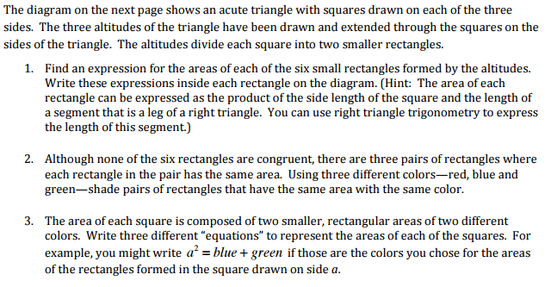
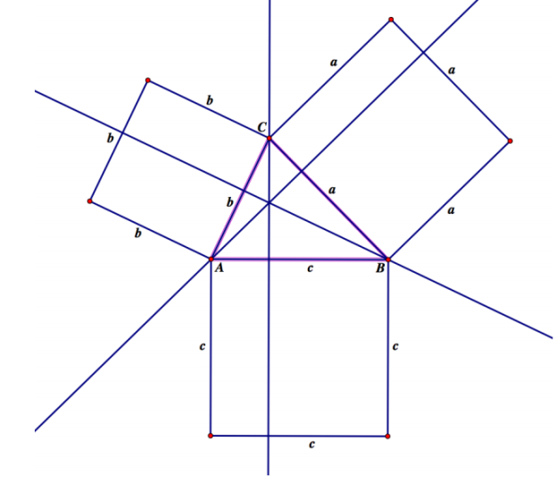

Slide 6
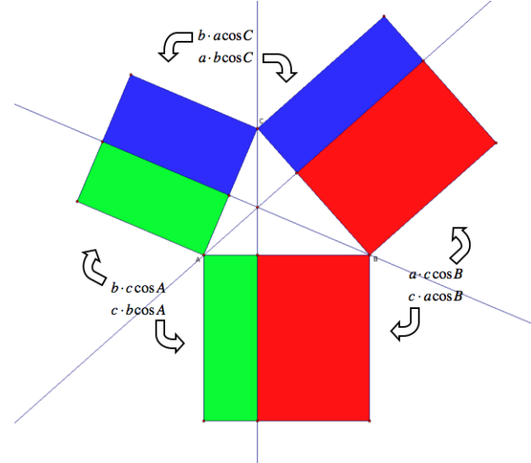

Slide 7
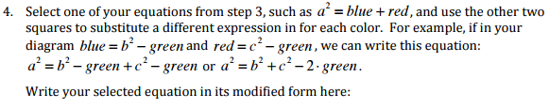


Slide 8

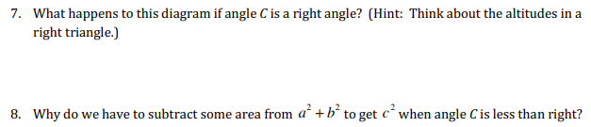

Slide 9
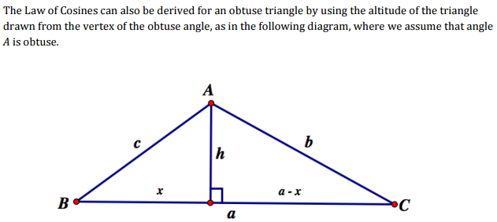


Slide 10


Slide 11

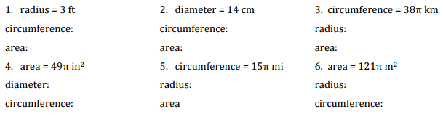

Slide 12
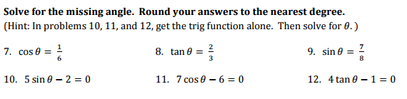

Slide 13
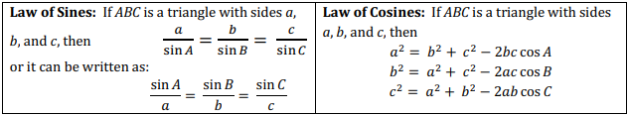
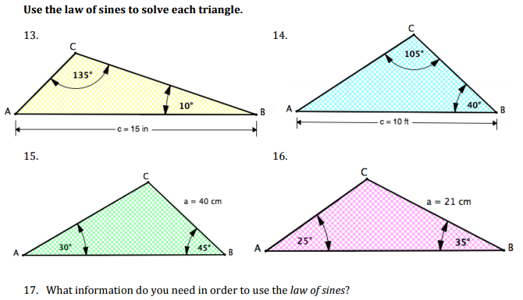

Slide 14
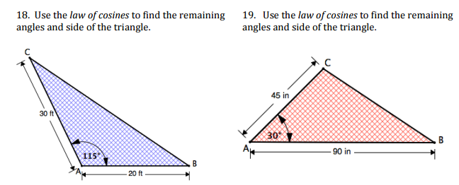
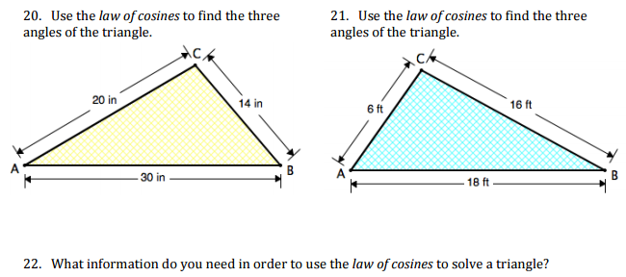

Slide 15
