Slide 1
Please Put phones and devices in a pocket in your backpack. Thank you
EQ: Are there other ways to describe the location of a point in the plane other than by giving its x- and y- coordinates?

Slide 2
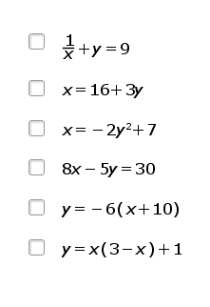
Warm Up
Select all the equations that are
represented by a straight line.
2. Draw the line $y=2x+3$
3. Select an expression that is
Equivalent to$\sqrt{3^{8}}$
$3^{\frac{1}{4}}$
$3^{3}$
$3^{4}$
$3^{6}$

Slide 3
EQ: Are there other ways to describe the location of a point in the plane other than by giving its x- and y- coordinates?

Slide 7

Notes:
Radian is another way to measure an angle
Radian is based on the unit circle
On unit circle the radius is 1 unit
On unit circle the circumference is $2π\left(1\right)=2π$
$360°=2π$
$180°=π$
$90°=\frac{π}{2}$
$45°=\frac{π}{4}$
$30°=\frac{π}{6}$
$60°=\frac{π}{3}$
If it is in degrees, there **must** be a degree sign
If there is no degree sign it is understood that it is in radians
To Change:
Degrees to Radians
Multiply by $\frac{π}{180}$
Radians to Degrees
Multiply by $\frac{180}{π}$

