Slide 1
Please Put phones and devices in a pocket in your backpack. Thank you
EQ: How does the unit circle simplify our work with trigonometric functions?

Slide 2
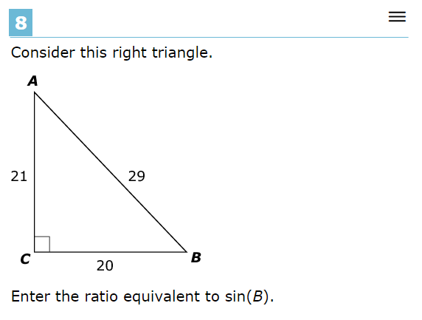
Warm Up

Slide 3
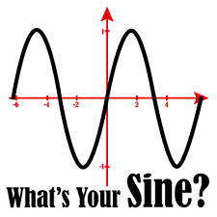
EQ: How does the unit circle simplify our work with trigonometric functions?

