Slide 1
Please Put phones and devices in a pocket in your backpack. Thank you
EQ: Are there any angles for which I can find the value of the sine or cosine without using a calculator?

Slide 2
Warm Up
Graph $f\left(x\right)=3x^{2}−12x+9$
What are the x-intercepts of the parabola in #1?
What is the minimum of the parabola in #1?
Mike earns $6.50 per hour plus 4% of his sales. Write an equation for Mike’s total earnings, E, when he works x hours and has a total of y sales, in dollars.
The basketball team sold hats and t-shirts as a fund-raiser. They sold a total of 23 items and made a profit of $246. They made a profit of $10 for every t-shirt they sold and $12 for every hat they sold. Determine the number of hats and the number of t-shirts the basketball team sold.

Slide 3
Warm Up
Graph $f\left(x\right)=3x^{2}−12x+9$
What are the x-intercepts of the parabola in #1?
What is the minimum of the parabola in #1?

Slide 4
Warm Up
Mike earns $6.50 per hour plus 4% of his sales. Write an equation for Mike’s total earnings, E, when he works x hours and has a total of y sales, in dollars.
The basketball team sold hats and t-shirts as a fund-raiser. They sold a total of 23 items and made a profit of $246. They made a profit of $10 for every t-shirt they sold and $12 for every hat they sold. Determine the number of hats and the number of t-shirts the basketball team sold.

Slide 5
EQ: Are there any angles for which I can find the value of the sine or cosine without using a calculator?

Slide 6
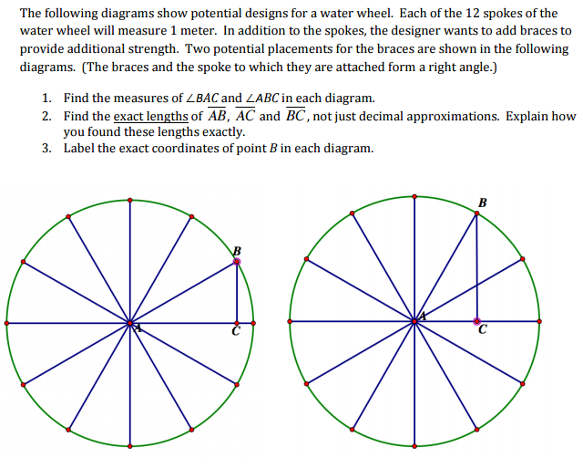

Slide 8
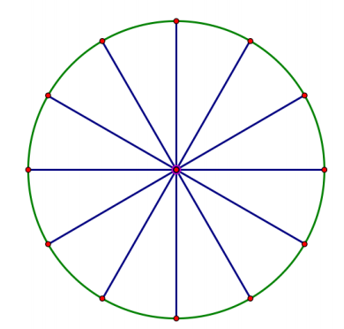
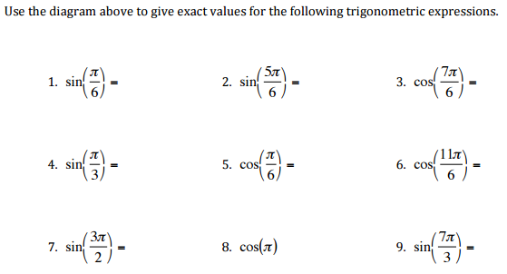

Slide 9
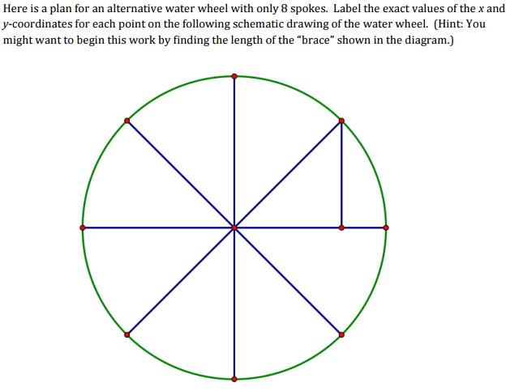

Slide 10
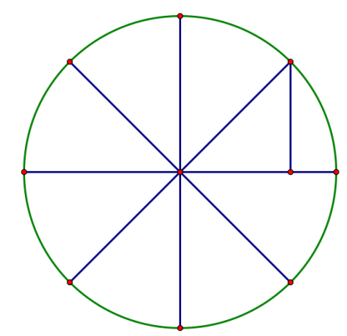
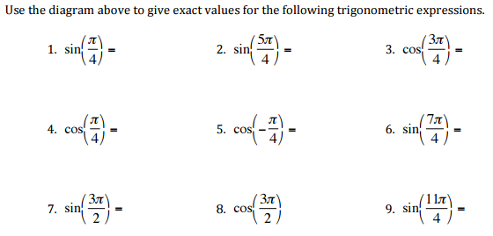

Slide 11
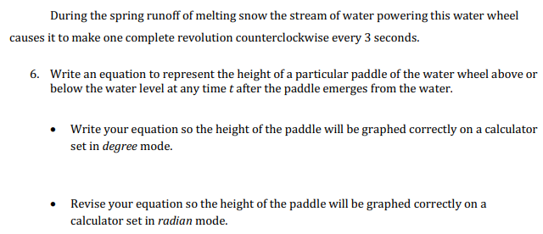

Slide 12
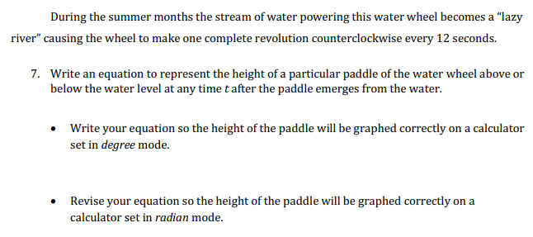

Slide 13
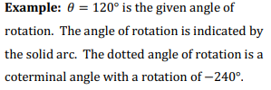
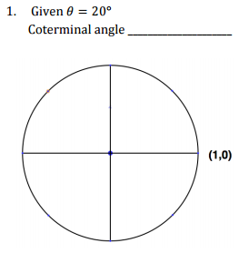
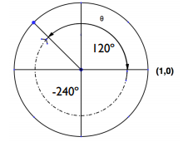

Slide 14
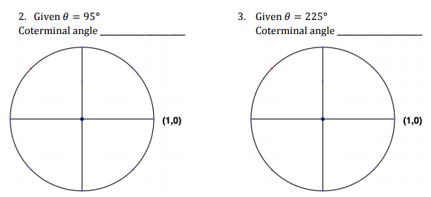

Slide 15
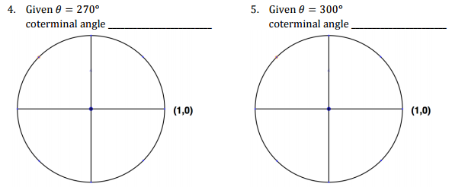

Slide 16
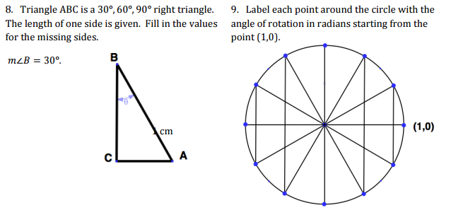

Slide 17
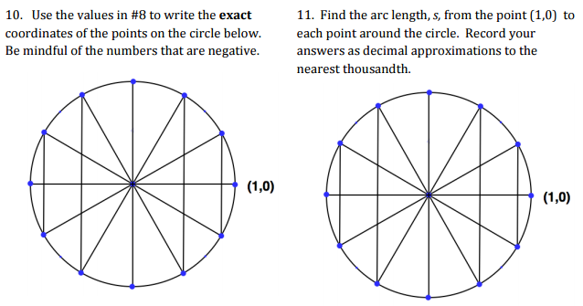

Slide 18
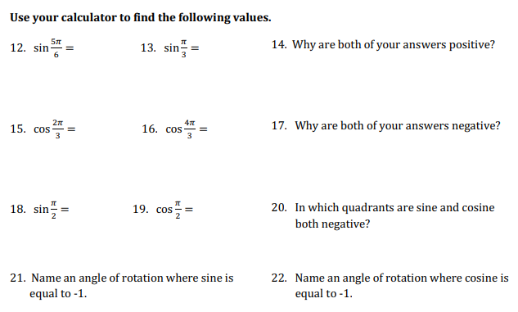

Slide 19
