Slide 1
Please Put phones and devices in a pocket in your backpack. Thank you
EQ: How can I represent the horizontal and vertical motion of a rider on a Ferris wheel if her starting point varies? When should I use a sine equation and when should I use a cosine equation, or does it matter?

Slide 2
Warm Up

Slide 3
EQ: How can I represent the horizontal and vertical motion of a rider on a Ferris wheel if her starting point varies? When should I use a sine equation and when should I use a cosine equation, or does it matter?

Slide 4
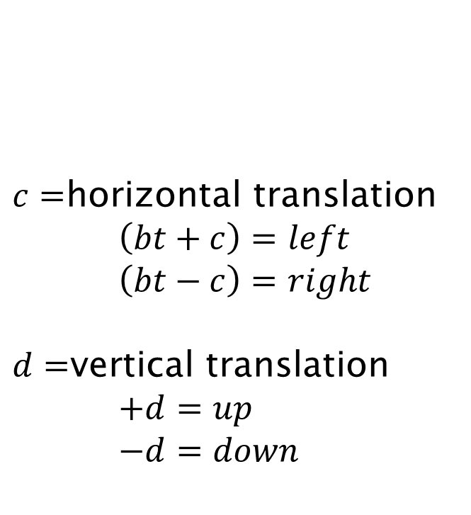
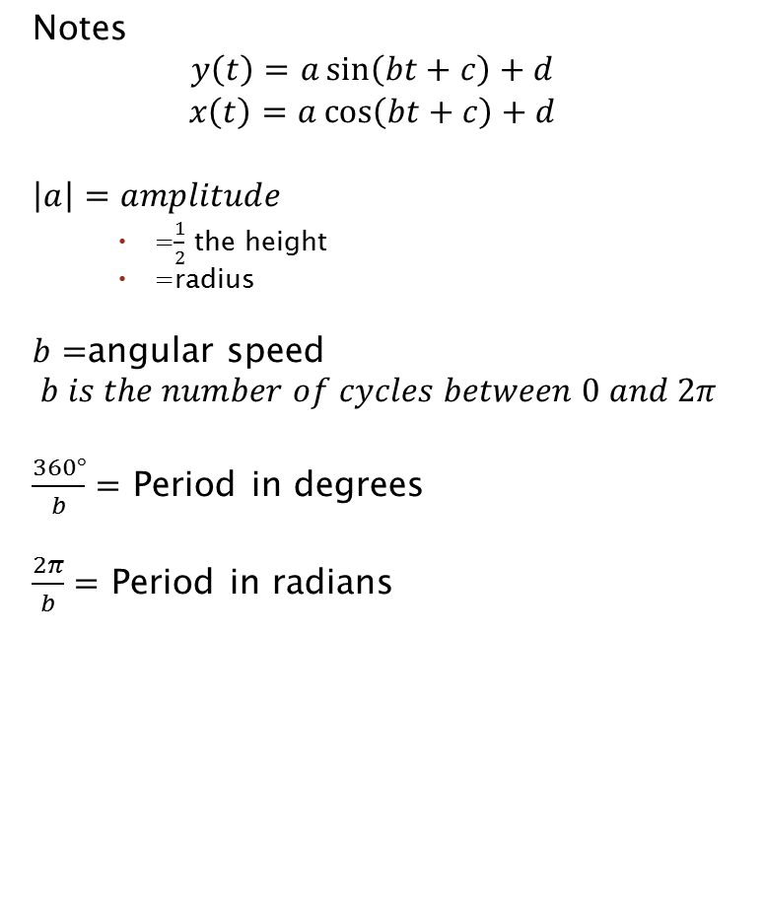
Notes
$$y\left(t\right)=a\sin\left(bt+c\right)+d$$
$$x\left(t\right)=a\cos\left(bt+c\right)+d$$
$$\left|a\right|=amplitude$$
=$\frac{1}{2}$ the height
=radius
$b=$angular speed
$$b is the number of cycles between 0 and 2π$$
$\frac{360°}{b}=$ Period in degrees
$\frac{2π}{b}=$ Period in radians
$c=$horizontal translation
$$\left(bt+c\right)=left$$
$$\left(bt−c\right)=right$$
$d=$vertical translation
$$+d=up$$
$$−d=down$$

Slide 6
$$y\left(t\right)=\operatorname{asin}\left(bt\right)+d$$
$$x\left(t\right)=\operatorname{acos}\left(bt\right)+d$$

