Slide 1
Integrated Math Three Module Two Test Review

Slide 2
If $\log_{a}{b}=c$ , is it possible for c to equal a negative number? Explain.

Slide 3
Simplify ${\left(7b^{−5}\right)}^{2}$?

Slide 4
Expand $\log_{2}{{\left(\frac{2}{xy}\right)}^{3}}$

Slide 5
Write equivalent statements to the following argument. $\log_{7}{x}−\log_{7}{3}=0$.

Slide 6
We know that $f\left(x\right)$ and $g\left(x\right)$ are inverses of one another. What can you conclude about this inverse relationship?

Slide 7
We know that $f\left(x\right)$ and $g\left(x\right)$ are inverses of one another. What can you conclude about this inverse relationship?

Slide 8
We know that $f\left(x\right)$ and $g\left(x\right)$ are inverses of one another. What can you conclude about this inverse relationship?

Slide 9
a. $\log_{8}{0}=$
b. $\log_{3}{27}=$
c. $\log_{7}{7}=$
d. $\log_{5}{1}=$

Slide 10
If $\left(x\right)=\log_{x}{243}$ , then $f\left(3\right)=$

Slide 11
What is the base of $\log{x}$ ?

Slide 12
Find a point on the graph of $y=\log_{7}{x}$ ?

Slide 13
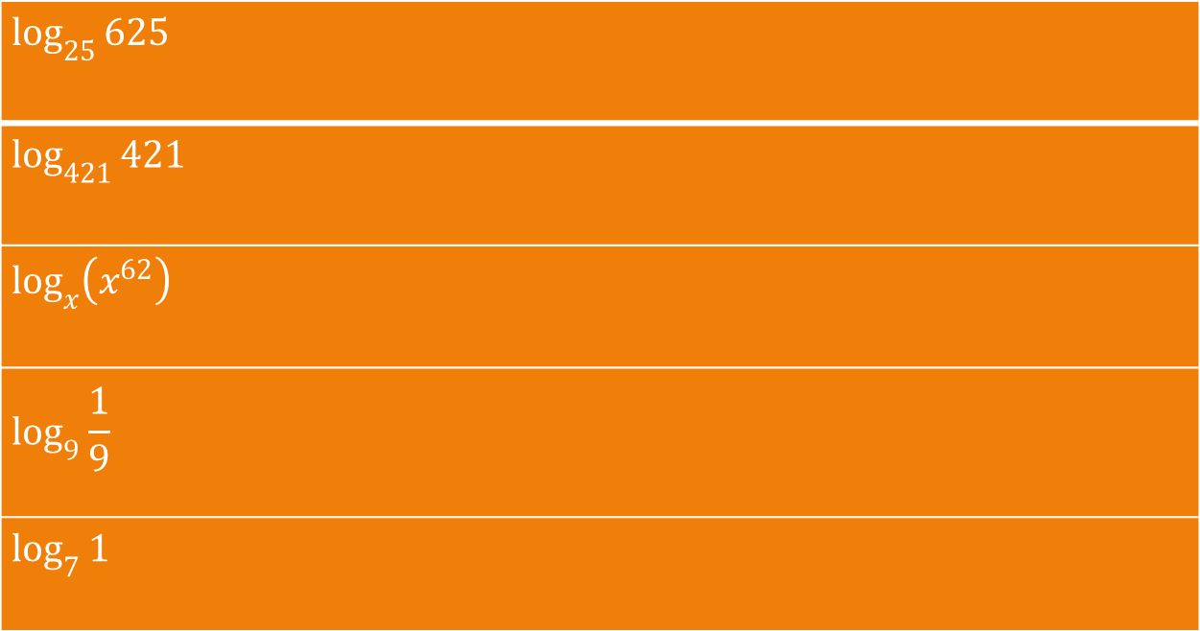
$$\log_{25}{625}$$
$$\log_{421}{421}$$
$$\log_{x}\left(x^{62}\right)$$
$$\log_{9}{\frac{1}{9}}$$
$$\log_{7}{1}$$

Slide 14

Answer the following questions without using a calculator.
(Hint: $\log_{6}{2=.39, \log_{6}{3}=.61, \log_{6}{7}=1.09, \log_{6}{5}=.9}$)
16. $\log_{6}{16}$ 17. $\log_{6}{8}$ 18. $\log_{6}{24}$
19. $\log_{6}{\frac{1}{7}}$ 20.$\log_{6}{\frac{16}{3}}$ 21. $\log_{6}{25}$

